Slide 1
Performance measurement

Slide 4
Performance measurement

Slide 5
Lesson 2: Performance measurement
What to measure for the different domains?
Client
Network
SPO Servers
Notes:
Note: We will go over how to find these measurements in the coming tools module.

Slide 6
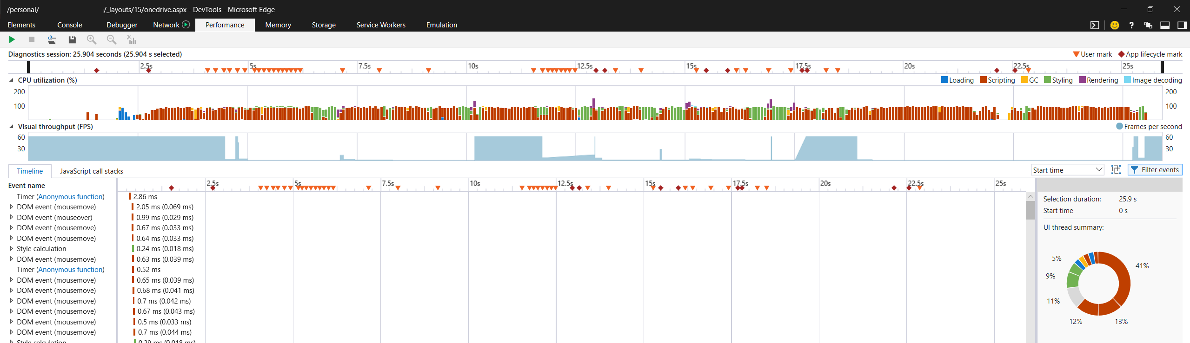
What to measure on the Client?
Browser
Performance measurement in the browser
Timeline
Legend
CPU utilization
Summary
Request waterfall

Slide 7
What to measure on the Client? (cont.)
OS
Standard perfmon counters
General CPU utilization
General Memory utilization

Slide 8
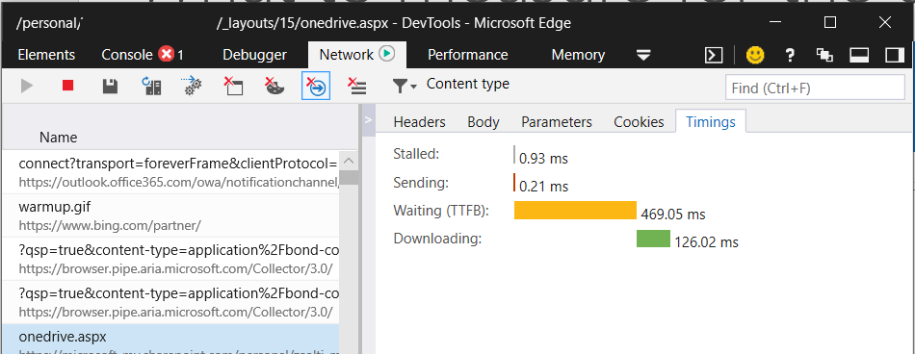
What to measure on the Network?
Time to first byte
Not really network (everything other than client).
Still good to see if it is client or not.
Download times
For files.
Either file is too big (for example: ASPX) or slow network.
Notes:
TTFB measures the duration from the client making an HTTP request to the first byte of the page being received by the client's browser.

Slide 9
What to “measure” on the SPO servers?
SPIISLatency (g_iisLatency):
Time elapsed (ms) between the BEGIN_REQUEST event in the Internet Information Services (IIS) pipeline, and the creation of the SPRequest.
No threshold guideline.
Best is 0
No SLA.
Notes:
SPIislatency is the time taken in the front-end Web server after the request has been received the front-end Web server, but before the Web Application begins processing the request.
-Typically not too helpful with diagnosing issues yourself, but will be something that support may look at depending on the issue.

Slide 10
What to “measure” on the SPO servers? (cont.)
SPRequestDuration (g_duration):
Time elapsed expressed (ms) for the processing of an SPRequest.
Time spent in the processing of the SharePoint logic.
Only calculated for ASPX pages.
Might be in header or page content (g_duration).
Threshold guideline.
0-2 seconds
No SLA.
Notes:
SPRequestDuration, displays the amount of time that the request took on the server to be processed. This can help determine if the request is very heavy and resource intensive. This is the best insight you have into how much work the server is doing to serve the page.

Slide 11
What to “measure” on the SPO servers? (cont.)
SPClientServiceRequestDuration:
Elapsed time (ms) between the Begin_Request and End_Request events of Client Service calls.
No Threshold guidelines.
No SLA.
X-SharePointHealthScore:
Indicates the utilization of the server in on-prem.
Not an indicator in SPO.
Don’t use on-prem reference articles/blogs for SPO.
Notes:
https://docs.microsoft.com/en-us/office365/enterprise/diagnosing-performance-issues-with-sharepoint-online

Slide 12
What tool can be used for basic troubleshooting on the client?
Browser
What does the TTFB abbreviation mean?
Time to First Byte
What counter can give information about the server-side page render time?
SPRequestDuration

Slide 13
You should be familiar with the various tools that can be used in each performance domain.
On the client-side major browsers give most information required for troubleshooting.
While network troubleshooting can become complicated, basic information can be found in the browser as well.
Although you do not have access to the SharePoint Online servers, the server-side page rendering information can be found in the page content.

Slide 14

Questions?
Notes:
Do not answer these yet. Bring these up now so that the students can think about their answers after we run through the rest of the modules.

